Slide 1
Real-time Sign Language Interpretation System
Presented by: Mentored By:
Avantika Mishra Dr. Soumya Priyadarsini Panda
Isha Bharadwaj
Annada Gumansingh
Anmol Ray

Slide 2

Problem Statement
Learning Sign language requires significant amount of time.
Different countries have their respective form of sign gesture communication which results in non-uniformity.
Our project aims at bridging the gap and ensuring the inclusion of deaf and mute community into the conventional world.

Slide 3
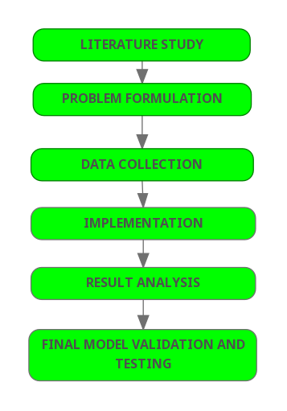
Workflow Diagram
The project has been done according to the given workflow diagram.

Slide 4


Software/Tools Used
TOOLS USED
TensorFlow Object Detection API
Python
OpenCV
LabelImg
SSD MobileNet
SOFTWARE USED
Google Colab
Jupyter Notebook
HARDWARE USED
Local machine: 64-bit operating system, x-64 based processor
In-built camera as webcam

Slide 5
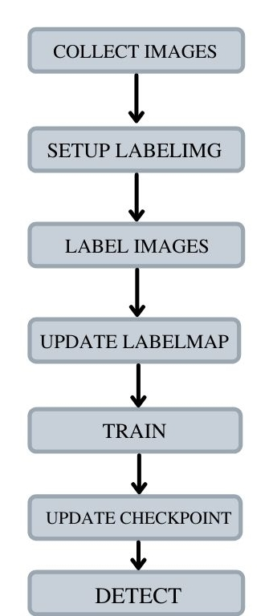
Details of the Project
Coded in Javascript to leverage webcam in colab to collect images for training.
Setup labelIng, which is an open source package that allows to label images for object detection.
Labelled each one of the sign language poses on local machine.
Labelmap is a representation of all the different objects that are in the model.
Trained the model after setting up the configuration.
This loaded the model and regenerated it based on the training.
Detected sign language in real time.

Slide 6
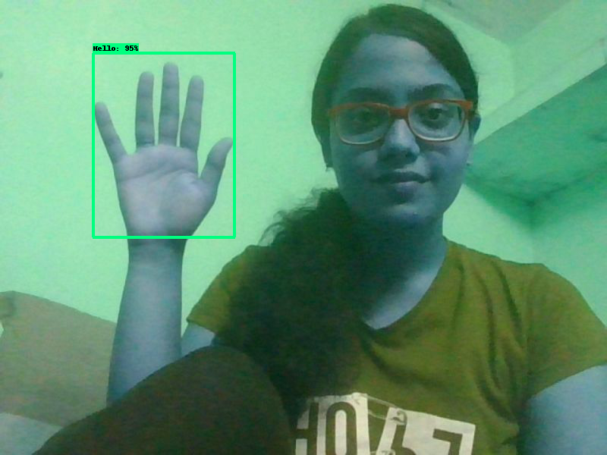
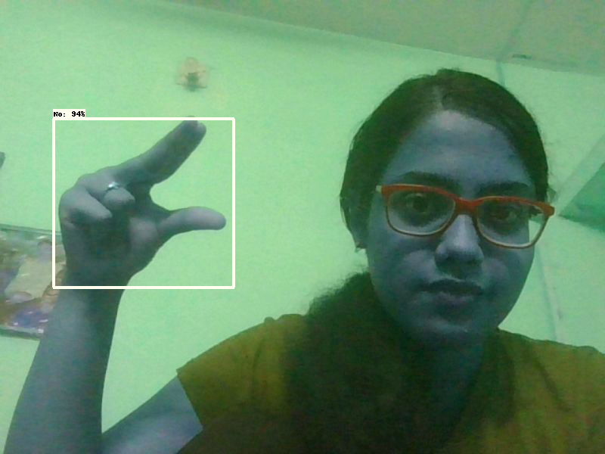
Results

Slide 7
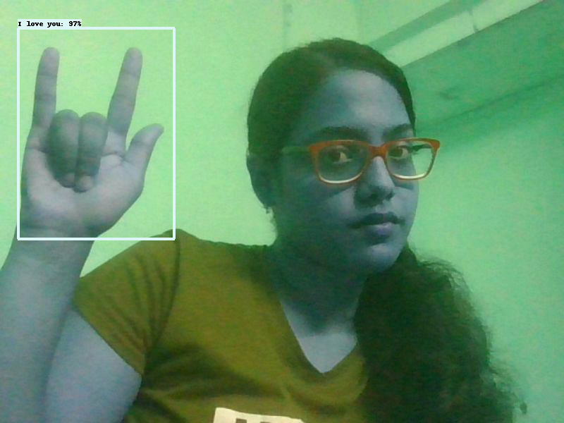
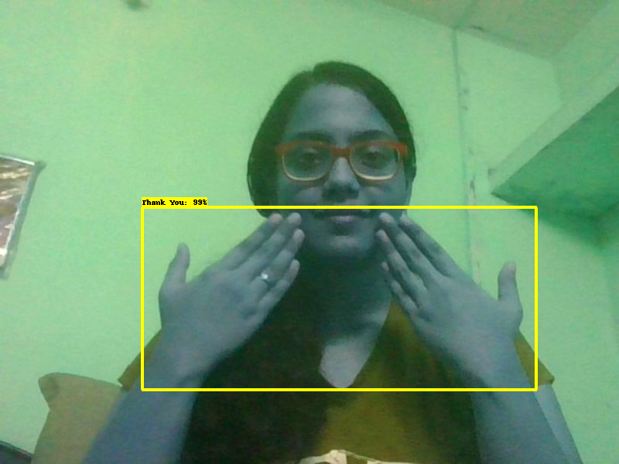
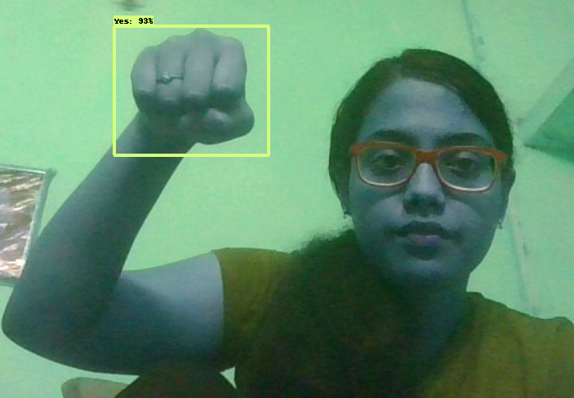
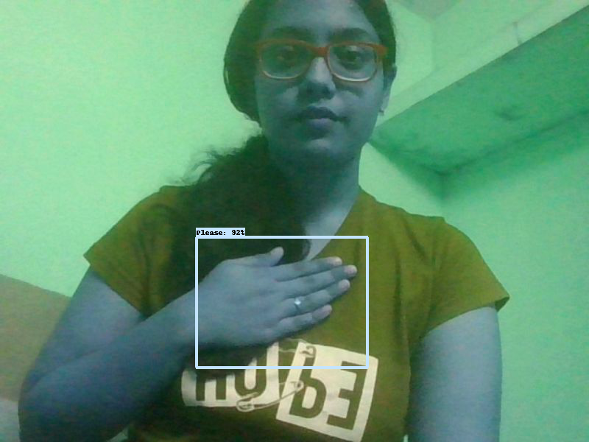
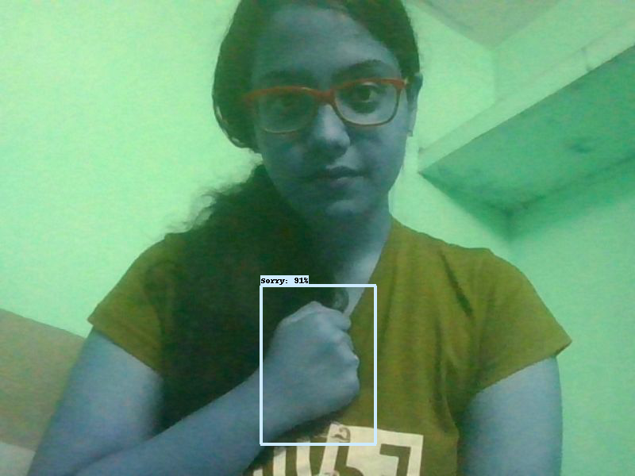
Results
Our model now recognises the following sign languages:
- Hello,
- I Love You
- Yes
- No
- Sorry
- Thank You
- Please

Slide 8

Demo

Slide 9
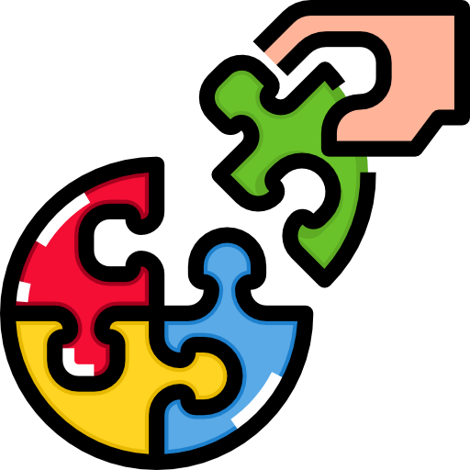
Contribution To Society
Integrate the deaf and mute community into the conventional world..
Smoothen the day-to-day interaction of deaf and mute people.
Recognise the diverse range of sign languages present around the globe.
Provide a feasible platform for the conventional world to interact with the deaf and mute community.
Eliminate discrimination because of the perceptable communication gap.

Slide 10

Future Scope
Upgrade dataset and training to recognise combination of static gestures.
Interpretation of facial expression by the real-time system.
Inclusion of different types of sign languages.
Integrating more words into the vocabulary of the system.

Slide 11
Timeline
February
1st - 9th February
Study of the research paper-Sign Language Recognition by Joshitha Gandra, Vaishnavi Patil, Prof. Gayathri Ananthanarayanan.
10th February
Started writing code and working on the video classification technique.
15th - 25th February
Worked on the code and tested it. Got unsatisfactory results so started looking for newer ways to solve the problem.
27th February
Discussion on Real Time Sign Language Interpretation System using Tensorflow Object Detection and Python.
January
19th January
Submission of the Abstract for the project.
26th - 31st January
Study of the research paper- PyGlove: Symbolic Programming for Automated Machine Learning.

Slide 12
Timeline
March
2nd - 10th March
To get started, tried cloning the repo in Colab, attempted to set up the entire environment in local machine. But finally found solution and uploaded the repository in drive and mounted the drive to Colab. Set up labelImg.
11th - 26th March
Coding to collect images for deep learning using the webcam and OpenCV and encountered error while capturing video. Brainstormed several possible solutions for the same. Finally figured out the cause of the error and resolved it successfully.
April
1st - 15th April
Label each one of the sign language poses using the labelImg tool on local machine, as labelImg is not compatible with Google colab. Create labelmap and tf records which the object detection API uses.
16th - 30th April
Set up and updated the configuration.
Trained the model after hyperparameter tuning and loaded the train model from checkpoint after updating checkpoint. This loaded the model and regenerated it based on the training.
May
1st - 20th May
Tried training the model multiple times with different hyperparameter values to find the optimum results. Finally, detected sign language in real time using Javascript and Python.
21st - 30th May
Report writing and preparation for the final presentation.

Slide 13
References
[1] Daiyi Peng, Xuanyi Dong, Esteban Real, Mingxing Tan, Yifeng Lu Hanxiao Liu, Gabriel Bender, Adam Kraft, Chen Liang, Quoc V. Le, "PyGlove: Symbolic programming for automated machine learning", Advances in Neural Information Processing Systems, Vol. 33, pp. 96-108, 2020.
[2] Zhang Shujun and Qun Zhang, "Sign language recognition based on global-local attention", Journal of Visual Communication and Image Representation, Vol. 80, Article id: 103280, 2021.
[3] I. A. Adeyanju, O. O. Bello, and M. A. Adegboye, "Machine learning methods for sign language recognition: A critical review and analysis", Intelligent Systems with Applications, Vol. 12, Article id: 200056, 2021.
[4] Brandon Garcia, Sigberto Alarcon Viesca, “Real-time American Sign Language Recognition with Convolutional Neural Networks”, Stanford University Stanford, CA, 2016
[5] Sawant Pramada, Deshpande Saylee, Nale Pranita, Nerkar Samiksha, Mrs.Archana S. Vaidya, “Intelligent Sign Language Recognition Using Image Processing”, IOSR Journal of Engineering (IOSRJEN), Volume 3, Issue 2, PP 45-51, 2013
[6] Pratibha Pandey , Vinay Jain, “An Efficient Algorithm for Sign Language Recognition”, (IJCSIT) International Journal of Computer Science and Information Technologies, Vol. 6, 2015
[7] Nicholas Renotte, ‘RealTimeObjectDetection’, 2020 [Online]. Available: https://github.com/nicknochnack [Accessed: 27-Feb-2022]

Slide 14


